Slide 1
Advanced Topics in Mathematics

Slide 2
Introduction to the course content
Vector Calculus
Differentiation
Gradient, divergence, curl
Integration
Line integrals, surface integrals
Applications
Studying fluids : https://youtu.be/rB83DpBJQsE?t=18
Studying gravity: https://youtu.be/rB83DpBJQsE?t=23
Studying magnetic fields: https://youtu.be/rB83DpBJQsE?t=28
Maxwell’s equations : https://youtu.be/rB83DpBJQsE?t=356
Tracking populations (phase space states): https://youtu.be/rB83DpBJQsE?t=464
Cylindrical and Spherical coordinate systems
Partial Differential Equations
1D, 2D Heat equations
https://youtu.be/ToIXSwZ1pJU?t=421
https://youtu.be/QBjniA5XfKA?t=4
1D, 2D Wave equations
https://youtu.be/BSIw5SgUirg?t=20
https://youtu.be/wvJAgrUBF4w?t=45

Slide 3
Reviewing Vectors
Definitions, summing, scaling, dot product, cross product

Slide 4
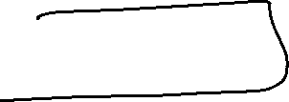








Reviewing: Definitions, adding, scaling, dot product (slides 1-41)
Class activity
Find

Slide 5



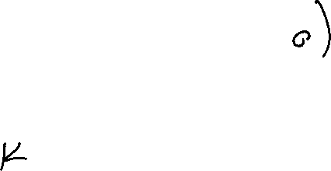



Reviewing: cross product, (Slides 42-58)
Class activity
Let
Find

Slide 6
https://studylib.net/doc/6953072/conics-summary
Scalar fields
Class activity

Slide 7
Vector fields
Class activity:

Slide 8
Vector differentiation
Class activity

